Slide 1
Building iOS Swift apps
5030-201720_MCS5993_M: 5030-Topics in Computer Science
5031-201720_MCS4993_M: 5031-Topics in MA/CS

Slide 2
Agenda
Under the hood
Compiler
Command line tools
Jailbreaking

Slide 3
iOS Under the Hood
Based on Darwin (Apple Unix)
Closest to BSD flavor

Slide 4
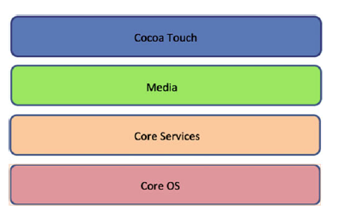
iOS Under the Hood – Core OS Layer
Notes:
The iOS platform is made up of several layers,
The bottom-most layer is called the Core OS layer and it contains the low-level technologies on the top of which all the other technologies are built. This is also the layer that directly interacts with the hardware. Apps leverage this layer when they deal with security or want to directly communicate with an external hardware accessory. It contains frameworks such as the Accelerate Framework, the core Bluetooth Framework, the Security Framework and the Kernel environment, such as networking, file systems, standard I/O, etc. It is the main layer of iOS, as almost everything in the OS uses this layer.
Also, while developing apps, you need to use this layer directly or indirectly.

Slide 5
iOS Under the Hood – Core Services Layer
Notes:
Core Services contains basic system services for the apps such as Core Foundation and Foundation Frameworks, which define the basic types all apps use. This layer also provides location, iCloud, social media, and networking feature access. The main features provided by this layer are peer-to-peer services for Bluetooth access, iCloud storage, data protection, in-app purchases, file sharing support, SQLite, XML Support, WebKit Framework, etc.

Slide 6
iOS Under the Hood – Media Layer
Notes:
The media layer, as its name suggests, contains graphics, video, and audio technologies to add multimedia to applications, which makes it easier to integrate media in apps and makes them look more beautiful and interactive. It contains graphic technologies like UIKit graphics and Core Animation Image I/O, audio technologies like AV Foundation, OpenAL, Core Audio, and Media Player Framework and video technologies like AVKit, AV Foundation, UIImagePickerController, and Core Media. This whole layer is all about the media and the frameworks available to make wonderful apps
look and feel even better

Slide 7
iOS Under the Hood – Cocoa Touch Layer
Notes:
The top-most and the last layer, Cocoa Touch, is a version of Cocoa library available in OS X. It contains key features needed to create iOS applications that define the appearance of the app. It has high-level features like Document Picker, TextKit, multitasking, storyboards, Apple push notification services, local notifications, and it has frameworks like the GameKit framework, the MapKit framework, the UIKit framework, etc.

Slide 8
iOS System Hierarchy
Notes:
Figure 1-3 is a screenshot of a jailbroken iPad revealing the contents of the root directory of an iOS device. By default, iOS provides no Terminal-like app and doesn’t permit normal users to access the contents of any directory.

Slide 9
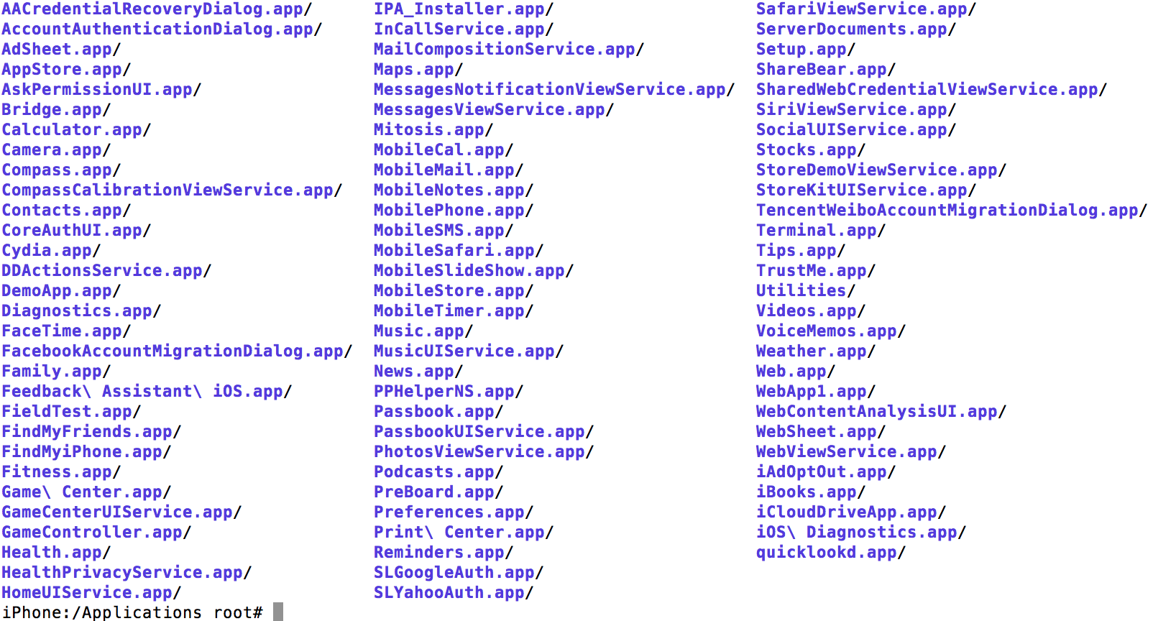
iOS System Hierarchy - Applications
Notes:
T he A pplications folder is a highly sensitive folder that contains all the necessary
apps to run iOS and is the home for all the native apps that come preinstalled on
your device from Apple. These apps can’t be uninstalled by a normal user and apps
in this folder can only be deleted on a jailbroken device using a File Manager with
root privileges or via shell access. Doing so can lead to unexpected results and is not
recommended. The native jailbreak apps (installed via the Cydia repository) also
reside here. The list of apps installed in this folder includes AppStore , Settings ,
Contacts , Dialer , Camera , etc.

Slide 10
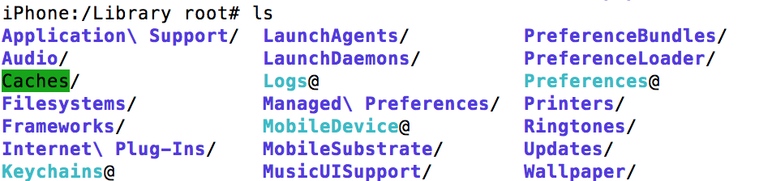
iOS System Hierarchy - Library
Notes:
This folder is a tweaked version of lib folder found in UNIX-based folders, used as
lib32 and lib64 to support multi-architecture. It contains all the necessary files and
executables to be used by the user and the applications. Similar to other modern UNIX
OSs, this folder contains shared libraries used by applications available for iOS. This
folder has the following child folders:

Slide 11
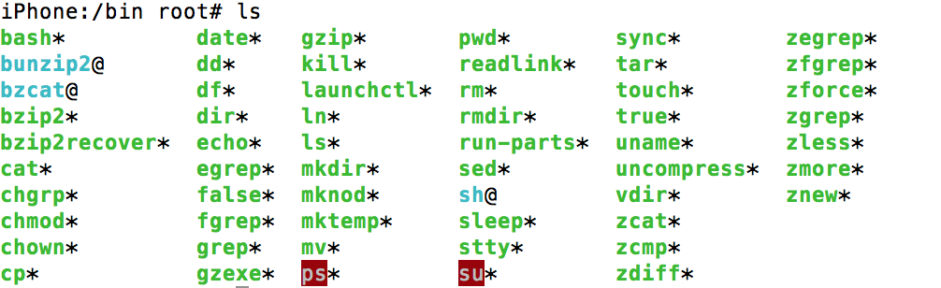
iOS System Hierarchy - Bin
Notes:
Like the bin directory in all other UNIX-based systems, bin contains all GNU core
utils used by the system, which are basically the text, file, or shell manipulation
utilities that come by default in iOS. On a jailbroken device, you can install more
supported utilities if needed. A few utilities in this folder include bash, chmod,
gunzip, pwd, touch, etc

Slide 12
iOS System Hierarchy
Dev
Lib
Sbin
Tmp
Developer
Notes:
Dev Directory
dev stands for devices, just like in other UNIX-based systems. This is a read-only directory
and contains hidden files managed by the kernel.
Lib Folder
lib is supposed to have shared library images that are used to boot the system and run
the commands in the root file systems. However, iOS stores these files in /private/var/
lib and /System/Library instead. Thus, iOS lib is generally empty.
Sbin Directory
sbin is similar to bin and contains executable programs to boot the OS. sbin contains
sensitive information and generally is available only to the root user on all UNIX-based
systems. sbin is where RAM disks are uploaded and has important files like mount, fsck,
and launchd for booting the OS. Deleting this folder or its contents may lead to a boot
loop.
Tmp Directory
As the name suggests, this directory contains temporary files; the /tmp directory in iOS is
a symlink to /private/var/tmp .
Developer Directory
This is an empty directory initially, but once you connect your device to Xcode and
click the Use For Development button, the contents of DeveloperDiskImage.dmg are
decompressed here.

Slide 13
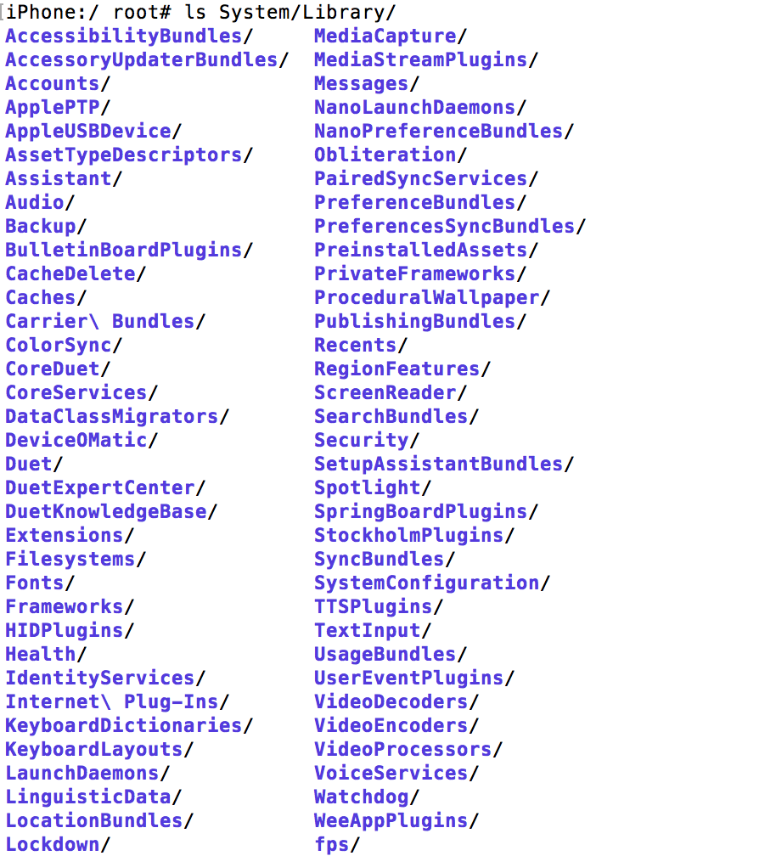
iOS System Hierarchy - System
Notes:
System Directory
This directory contains the data of the root partition, specifically the frameworks in the
Library sub-directory.

Slide 14
iOS System Hierarchy
Boot
Mnt
Usr
Notes:
Boot Directory
This directory is usually empty, but may contain over the air (OTA) update data when available.
mnt Directory
This directory is not really used by iOS, as seen in other UNIX systems. It is supposed to be used to mount a temporary file system by the system administrator, but in iOS even RAM disks are mounted in the /sbin directory .
usr Directory
This is a standard directory in all UNIX systems and contains static data.

Slide 15
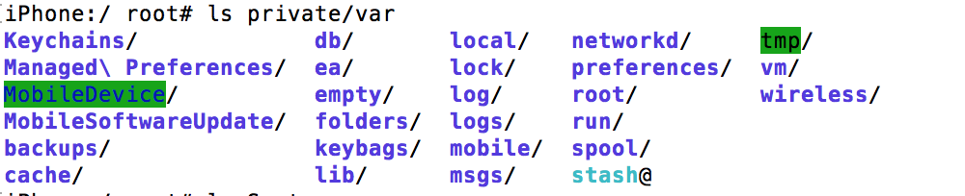
iOS System Hierarchy - var
Notes:
var Directory
This is the mount point of device user/data partition and is symlinked to /private/var .
It stores all App store applications, iTunes media, settings, photos, etc.

Slide 16
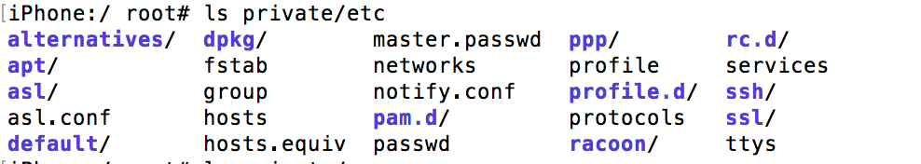
iOS System Hierarchy - etc
Notes:
This directory holds all the configuration files as specified by the Filesystem Hierarchy
Standard (HFS) and includes important files like launchd.conf , passwd , and hosts . It has
configurations files for Bluetooth, SSL, etc.

Slide 17
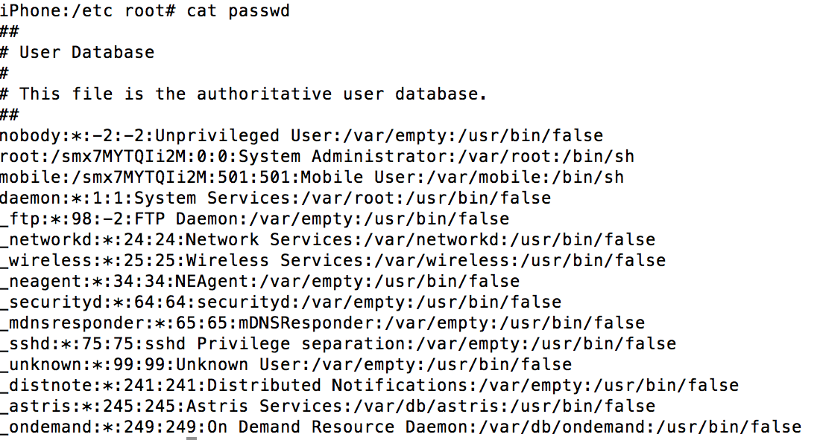
iOS System Hierarchy – /etc/passwd
Notes:
Password file. We know the password for root is alpine

Slide 18
Traditional Compiler
Notes:
At a high-level, the job of any compiler is to take source code and turn it into something that can run on a processor (machine code). As part of that process, the source code is typically turned into an intermediate form, optimized, and then transformed into machine code. Those jobs can be split up into three separate components – the frontend, the optimizer, and the backend.
https://www.accelebrate.com/blog/thinking-swift-part-ii/

Slide 19
LLVM Compilation – Low Level Virtual Machine
Notes:
LLVM is not a compiler in the traditional sense. It’s more appropriate to think of it as scaffolding that can be used for building actual compilers (hence the “infrastructure” part of the name). The result is a system that can support multiple languages and multiple hardware platforms without each compiler having to reinvent the wheel.
For this design to work, each frontend must translate the original source code into a common language that can be consumed by the optimizer. LLVM defines a new language for this purpose called LLVM Intermediate Representation (IR).

Slide 20
Swift Compilation
Notes:
LLVM IR is not something that can be packaged for deployment like Java bytecode or .NET IL. It is simply a step taken by the compiler on the road from source code to machine code. In the case of Swift, your code actually ends up getting transformed into two other formats before LLVM IR. Here is the whole picture for Swift:
AST – Abstract Syntax Tree
IL – Intermediate Lang
IR – Intermediate Representation

Slide 21
Peeling Back the Onion
let a = 3
let b = 4
let c = a + b
print(c)
Notes:
LLVM IR is not something that can be packaged for deployment like Java bytecode or .NET IL. It is simply a step taken by the compiler on the road from source code to machine code. In the case of Swift, your code actually ends up getting transformed into two other formats before LLVM IR. Here is the whole picture for Swift:
AST – Abstract Syntax Tree
IL – Intermediate Lang
IR – Intermediate Representation

Slide 22
swiftc –help
-dump-ast Parse and ... dump AST(s) -emit-sil Emit canonical SIL file(s) -emit-ir Emit LLVM IR file(s) -emit-assembly Emit assembly file(s)
Notes:
Run swiftc --help
If you look at some of the “modes” that are listed near the top of the output, you’ll see options that correspond to what’s shown

Slide 23
Compile file
swiftc –emit-executable onion.swift
./onion
Notes:
Compile our onion file
Should get the number…..7!

Slide 24
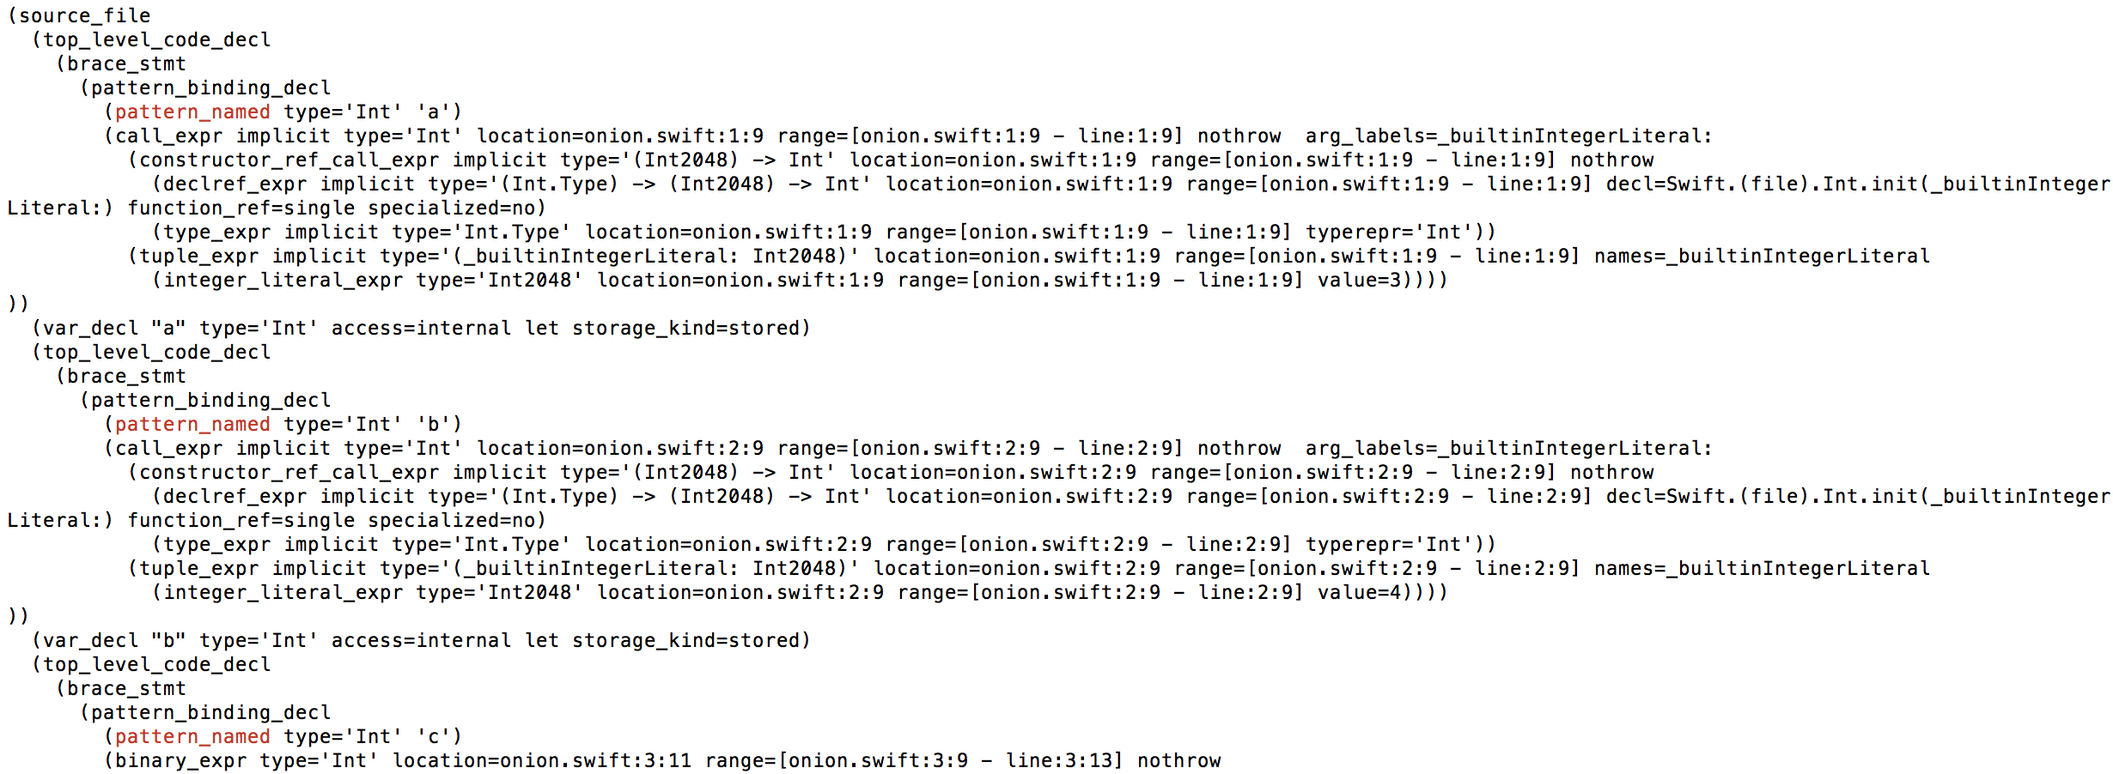
swiftc –dump-ast onion.swift
Notes:
Look at the Abstract Syntax Tree, declare a and b and then define the expression c.
DEMO

Slide 25
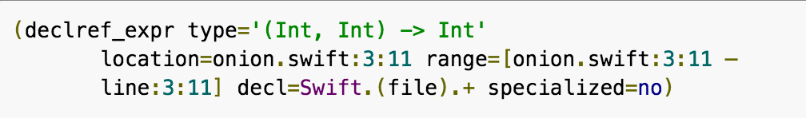
swiftc –dump-ast onion.swift
Notes:
Look at the Abstract Syntax Tree, declare a and b and then define the expression c.

Slide 26
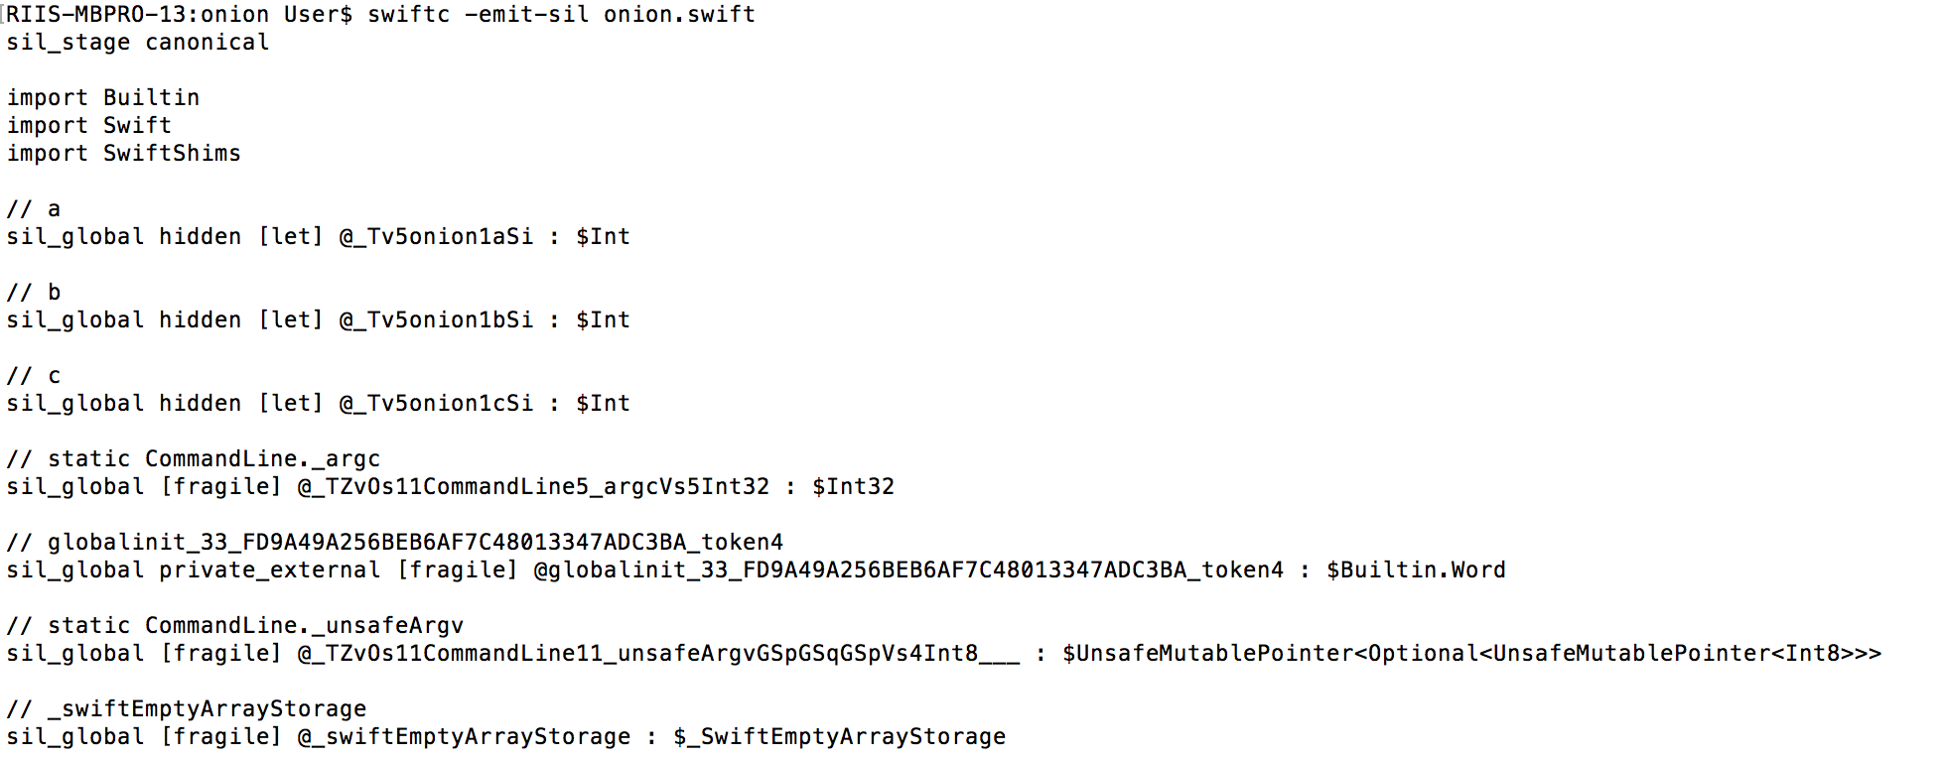
swiftc –emit-sil onion.swift
Notes:
The next layer of our onion is the Swift Intermediate Language that is generated from the AST. This intermediate form is used by the Swift optimizer to perform Swift language specific optimizations prior to generating the LLVM IR.
To view the SIL for our Swift application, execute the following command:
Well, this is even uglier to look at but that’s sort of expected since we’re moving closer to the machine code representation of our program. Once again, let’s see if we can spot the code that corresponds to “let c = a + b”.

Slide 27
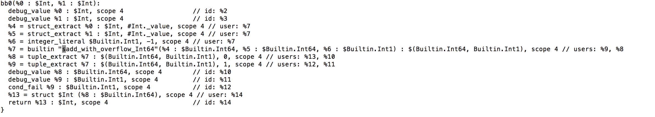
swiftc –emit-sil onion.swift
Notes:
What’s interesting here is that the addition operation is being performed through the use of a “builtin” function named “sadd_with_overflow”.
Builtin functions are special since they are available only to the Swift standard library and typically map directly to LLVM IR instructions.

Slide 28
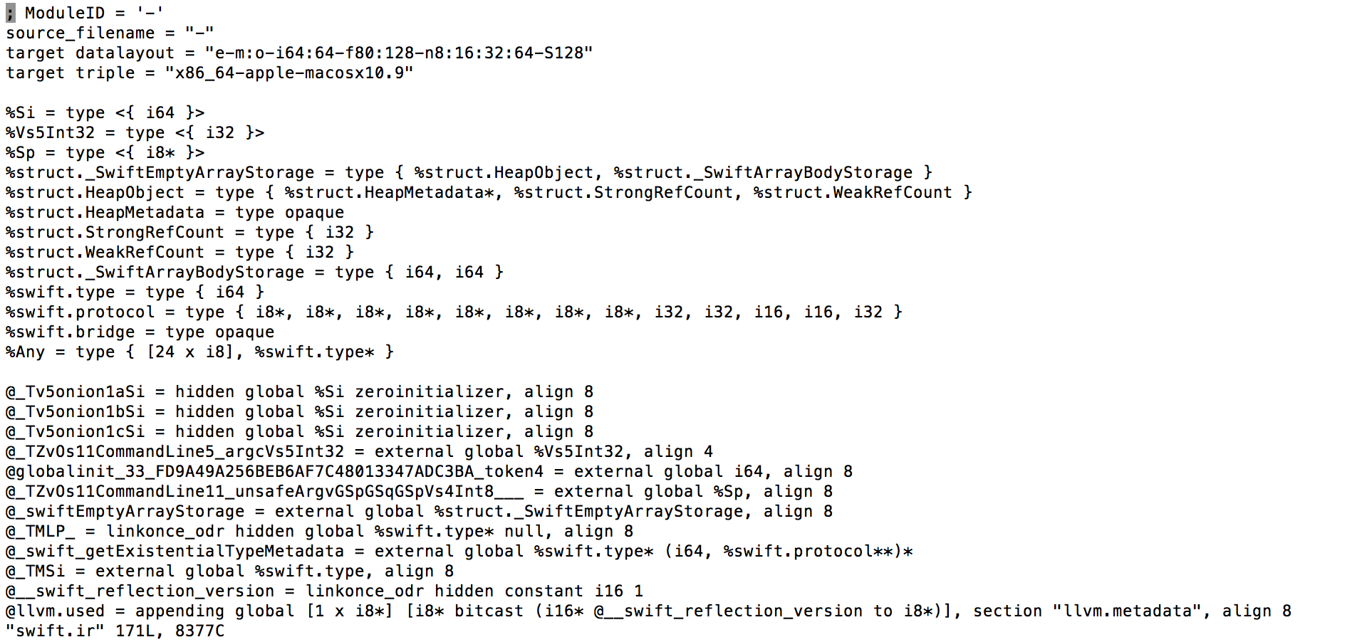
swiftc –emit-ir onion.swift
Notes:
It’s time for the next layer of the onion. This is the point where the SIL is translated into LLVM IR. This is the representation that the LLVM optimizer can work with to perform language-independent optimizations such as inlining and loop optimizations.
To peel back this layer, execute the following command to view the LLVM IR for our Swift program: (run –emit-ir)
Now things are really starting to look low-level.

Slide 29
swiftc –emit-ir onion.swift
%9 = call { i64, i1 } @llvm.sadd.with.overflow.i64(i64 %7, i64 %8)
Notes:
Once again, let’s see if we can spot our addition operation.
So, now our addition operation has been transformed into a call to the llvm.sadd.with.overflow.i64 instruction. One thing that’s interesting here is that if we were compiling a different language (e.g. Objective-C), we might very see the same LLVM IR.
LLVM is defined here http://llvm.org/docs/LangRef.html

Slide 30
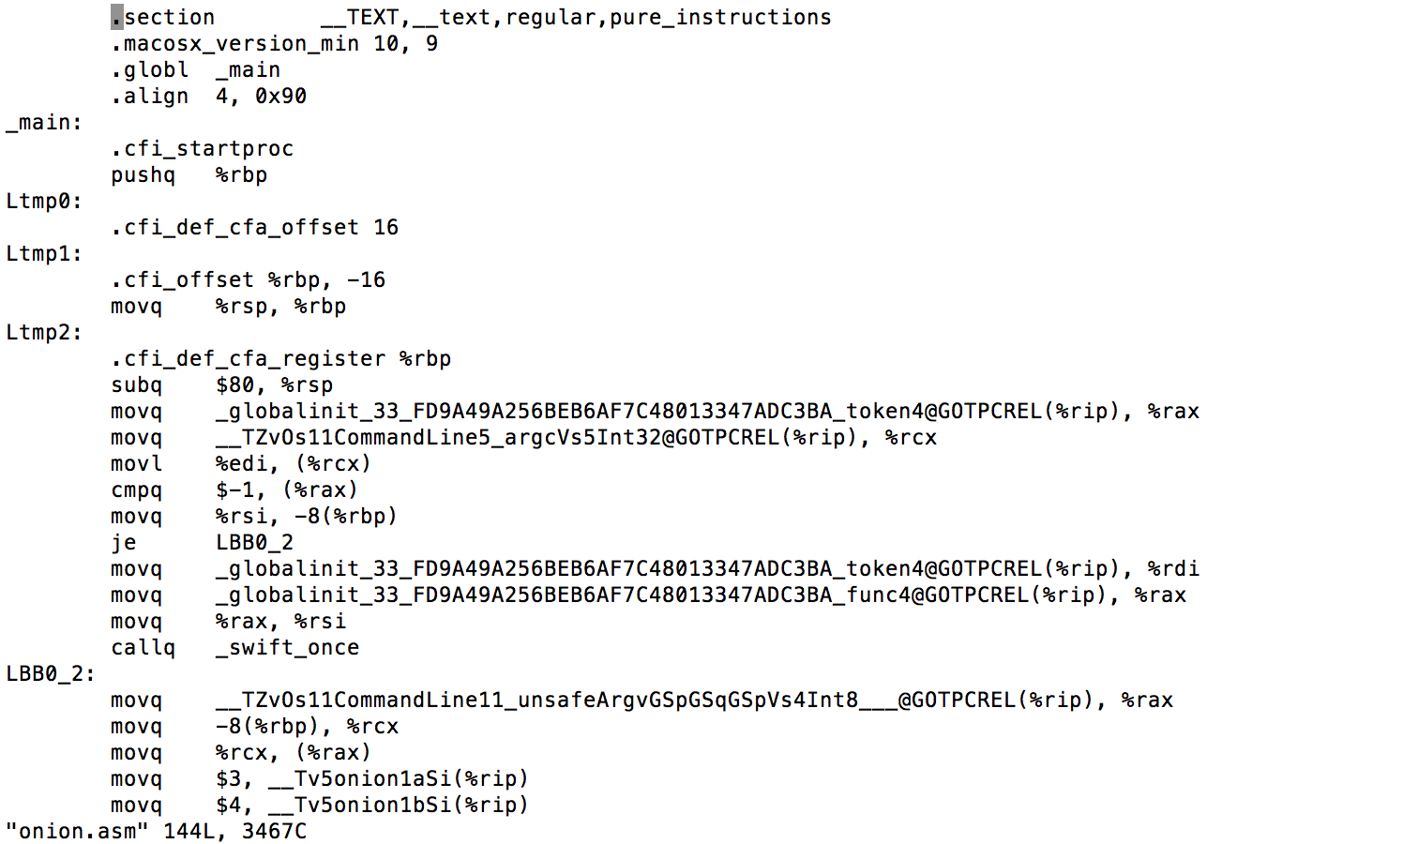
swiftc –emit-assembly onion.swift
Notes:
To view the assembly language that’s created from the LLVM IR, execute the following command:

Slide 31
swiftc –emit-assembly onion.swift
LBB1_2:
movq -16(%rbp), %rax
addq $16, %rsp
popq %rbp
retq
Notes:
we see that our high-level Swift code that adds two Swift integers does in fact translate into the proper (and very efficient) x86-64 addq instruction for adding two 64-bit integers.

Slide 32
Hopper App

Slide 33
Command Line Tools
Xcrun
swift-build (same as swiftc)
swift-build-tool
swift-demangle
swift-package
swift-test
Notes:
To start a REPL, we actually used two tools: xcrun and swift
Do
docker start swiftfun
Docker attach swiftfun
>swift-build
What gets called when you run swift build

Slide 34
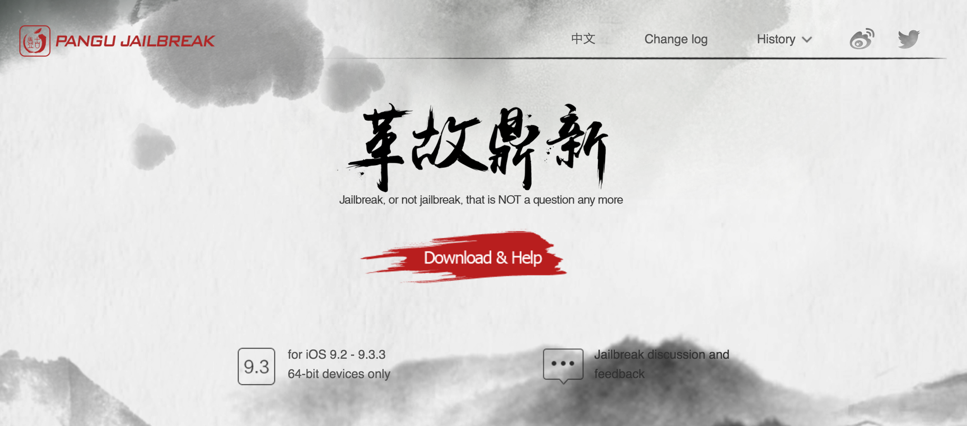
Jailbreaking
Notes:
PANGU

Slide 35
Jailbreaking
Notes:
1. Unzip the Cydia impactor file and run it. 2. Connect your iOS device to your computer and trust the computer on your iOS device. 3. Drag NvwaStone_1.0.ipa into Cydia impactor app.

Slide 36
Jailbreaking
Notes:
4. Input you email address( it’s your apple id)

Slide 37
Jailbreaking
Notes:
5. Input your apple ID password.

Slide 38
Jailbreaking
Notes:
6. Click OK button to continue.
7. Cydia impactor will automatically prepare everything based on your inputs and sign the IPA file. If everything is OK, the IPA file should be installed in your iOS device correctly. If you get error notifications, you probably input incorrect Apple ID or password. 8. On your device, Tap Settings > General > Device Management. You then see a profile for the developer under your “apple ID” heading. Tap the profile to establish trust for this developer. (An Internet connection is required to verify the app developer's certificate when establishing trust.) 9. On your device, find Pangu App and run it. 10. Click the "start" button to jailbreak your device.

Slide 39
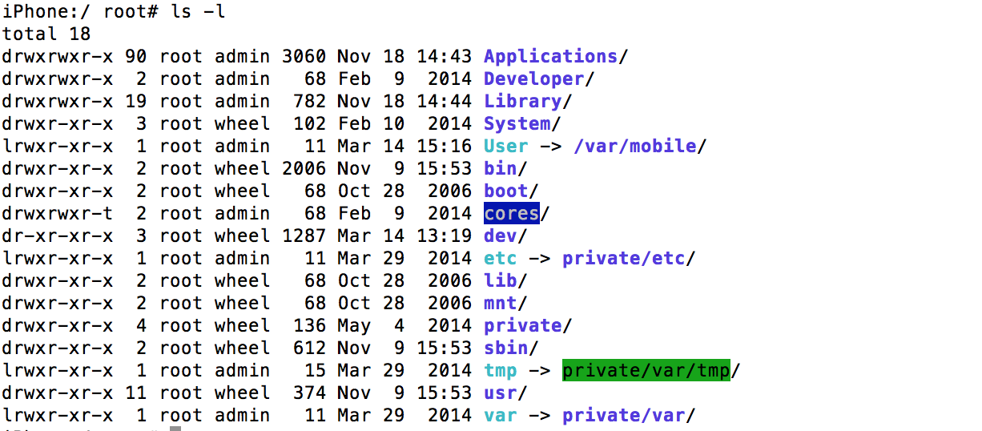
Jailbreaking
Notes:
PANGU

Slide 40
Jailbreaking
ssh root@10.5.2.5
cd /private/var/mobile/Containers/Bundle/Application
Notes:
IP address will change – password is alpine

Slide 41
Jailbreaking
Notes:
Cd into any of the directories to see an app and then the executable in the NAME.app directory is the executable file similar but much larger than our onion code before

Slide 42
OWASP Top 10
M1: Weak Server Side Controls M2: Insecure Data Storage M3: Insufficient Transport Layer Protection M4: Unintended Data Leakage M5: Poor Authorization and Authentication M6: Broken Cryptography M7: Client Side Injection M8: Security Decisions via Untrusted Inputs M9: Improper Session Handling M10: Lack of Binary Protections
Notes:
M1: Weak Server Side ControlsOnce you have proxies the application, try to access the Web-services used by the application from outside the application
M2: Insecure Data StoragePull the application databases from the device and search them for sensitive data
M3: Insufficient Transport Layer ProtectionProxy the application and search for exposed sensitive information in the http requests. Ensure the application uses https for sensitive information and that they are correctly using signed SSL certificates
M4: Unintended Data LeakageSearch common areas on the device such as shared preferences, log files etc to ensure the application is not exposing sensitive information
M5: Poor Authorization and AuthenticationEnsure users need to be logged-in to access information such as credit cards. Examine the criteria for account set-up, (Authentication of e-mail addresses, password strength etc), for weaknesses.
M6: Broken CryptographyUse the de-compiled source code and databases pulled from the device to see fi it is possible to identify the encryption/decryption algorithms used and decrypt and sensitive information that is encrypted in the database
M7: Client Side InjectionFind any text entry fields in the application end ensure they are not susceptible to injection attacks
M8: Security Decisions via Untrusted InputsDetermine which third parties are providing data to the application. Using the http proxy, see if it is possible to modify responses from these third parties to expose sensitive data
M9: Improper Session HandlingDoes the application leave the user logged-in when closed. Does starting the application give you access to stored credit cards without having to log back in?
M10: Lack of Binary ProtectionsWhen de-compiling the code, is it obfuscated. Are encryption keys hidden or visible within the code.

Slide 43
OWASP Top 10

Slide 44
Agenda
Agile Swift

